Slide 1


Nomads
World Travel
NOMADS
TRIP PLANNER
"Discover the world's wonders with ease. Your journey starts here, where every destination becomes an unforgettable adventure. Explore with us!"
LET’S GET STARTED
Page |
01.

Slide 2

Nomads
Looking For Travel under Budget?
Embark on unforgettable adventures without breaking the bank. Dive into our treasure trove of budget-friendly travel options, where every penny stretches farther, and dreams come true
About Us
Passionate explorers, connecting you to experiences.
ABOUT OUR
AGENCY.
Page |
02.

Slide 3



Nomads
ADVENTURES &
TRAVELS.
"Affordable adventures for solo, family, friends, and couples – limitless fun awaits!"
Travel Guide
Your compass to discovery, unlocking the world's wonders.
Fun Always First
In every journey's dance, fun leads the heart's melody.
Low Prices & Friendly
Budget-friendly skies, where warmth meets the wallet's delight
Page |
03.

Slide 4






Nomads
Tech
Behind
Nomads
TECH
STACK
Node js
Mapbox
React
BootStrap
Open AI
MongoDB
Page |
04.

Slide 5




Nomads
POPULAR
ACTIVITIES.
Explore & Adventure with NOMADS
Camping
Hiking
Mountain Bike
Fishing
Page |
05.

Slide 6





Nomads
Home
Bookings
Gallery
Sign In
DESTINATIONS
Around The Globe
An Amazing tool which enhances any tourists’s travel experience with a full proof planned journey.
AVAILABLE.
Kashmir, India
Andaman & Nicobar, India
Azure dreams unfurl, where pristine shores whisper tales of wonder.
Heaven's embrace, where snow-capped peaks touch the soul's serenity.
Page |
06.

Slide 7
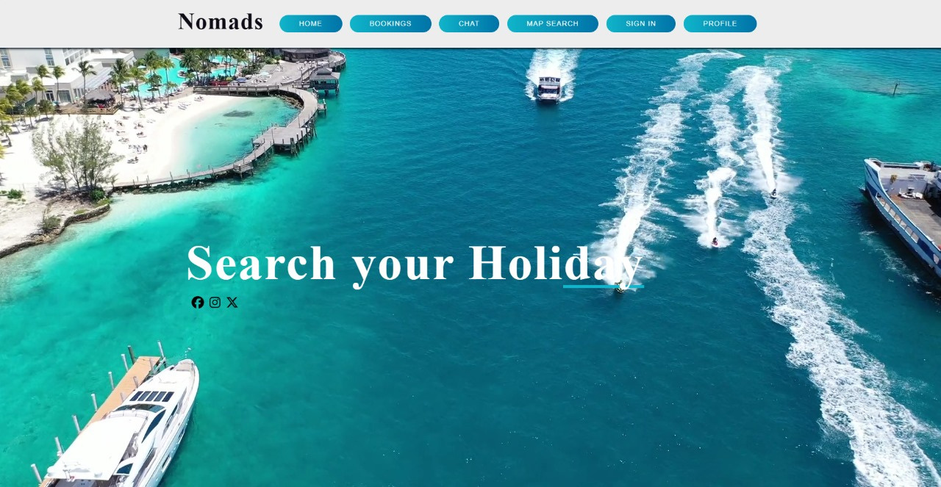

Nomads
Home
Bookings
Gallery
Sign In
HOME
PAGE
Home Page Welcomes the User with a calming page to ease out the process of planning trip.
The Navbar provides an efficient method for any User to navigate throughout the website.
Page |
07.

Slide 8
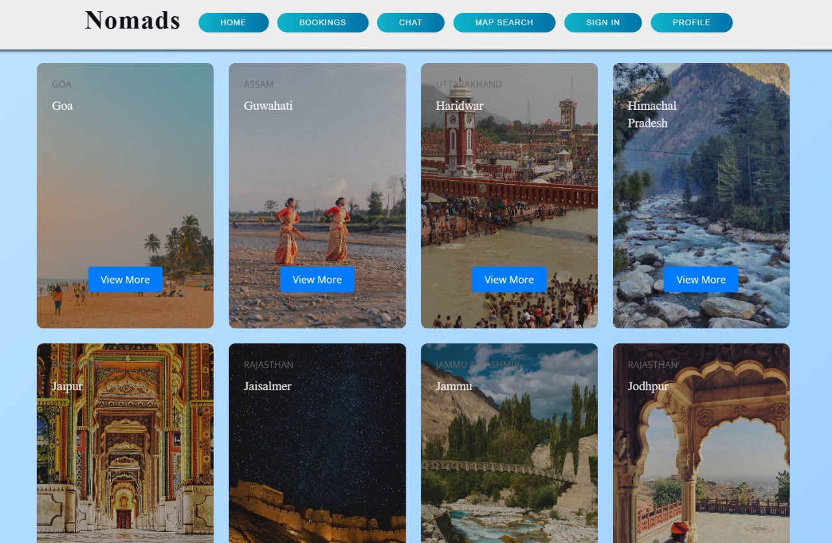
Nomads
Home
Bookings
Gallery
Sign In
TRAVEL
OPTIONS
Bookings for any User can be viewed through the detailed information present for each of the exisiting data.
Each Page’s Card re-directs the User to its reuired or place of Interest.
Page |
08.

Slide 9

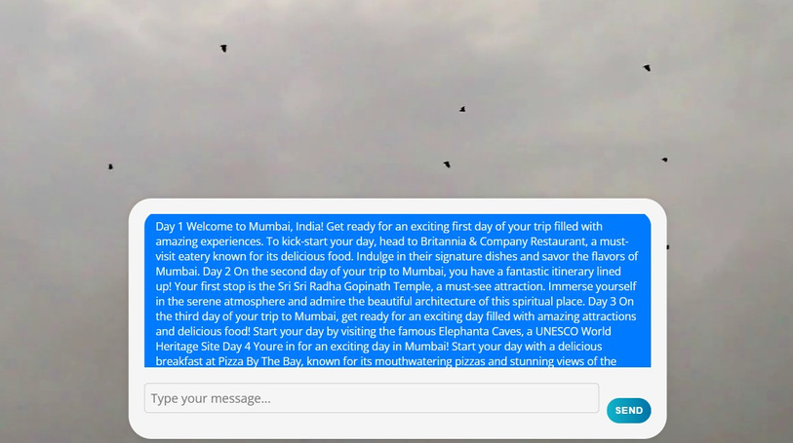
Nomads
Home
Bookings
Chatbot&API
Contact
Planning Chatbot
An LLM based Chatbot which plans the itinerary for the User depending upon Place.
EXPLORE
API-Map
MANY PLACES.
A mapbox based API search which gives a detailed view based search for any place on globe.
Page |
09.

Slide 10
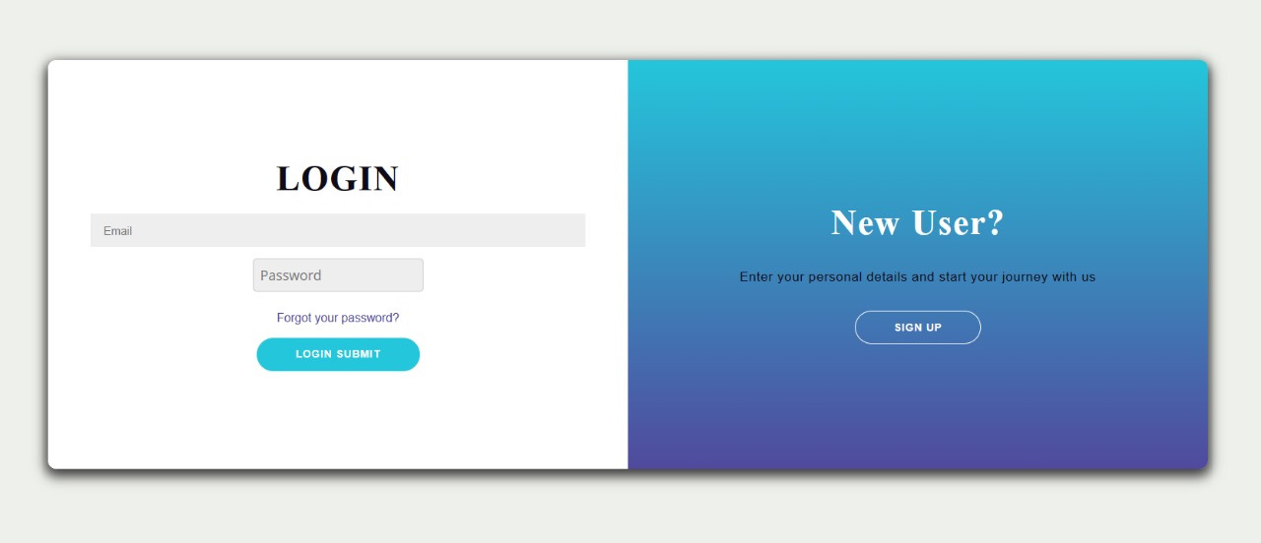
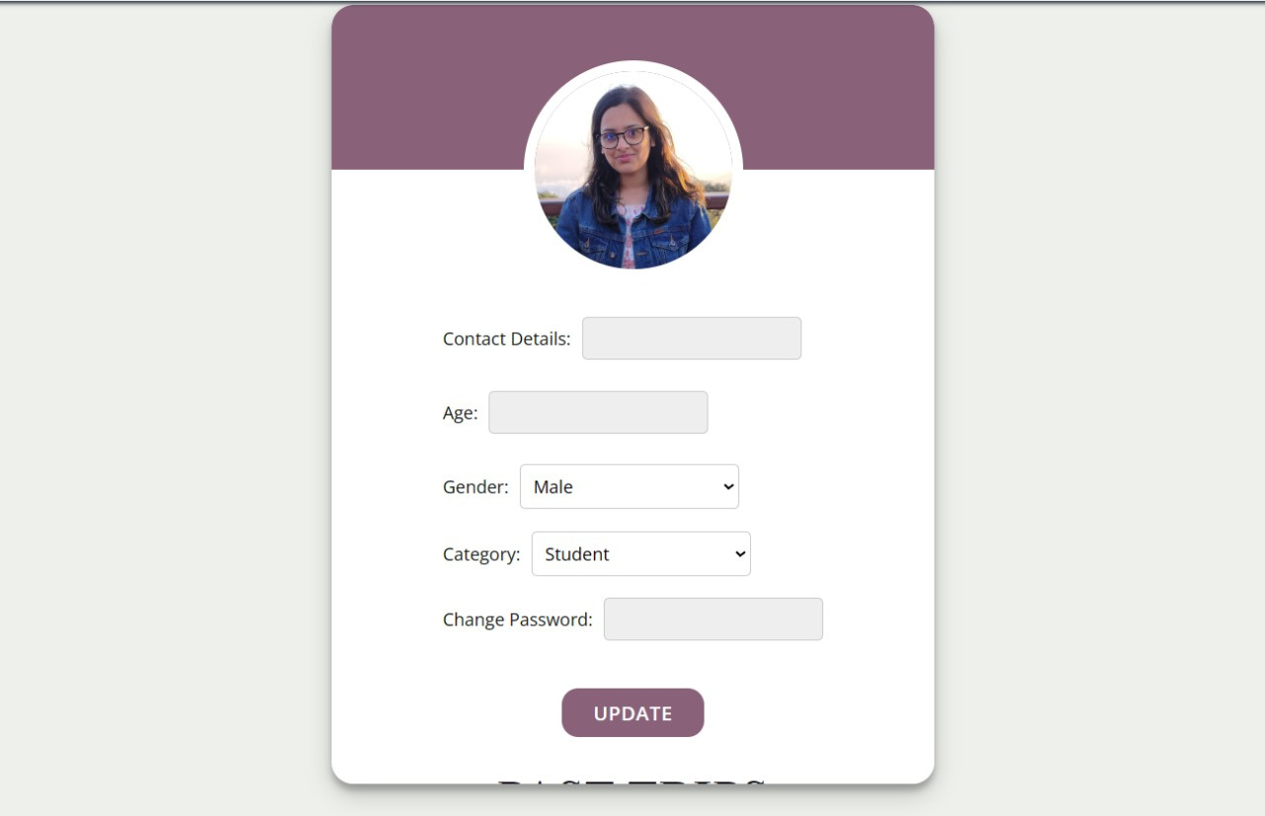
Nomads
Home
Bookings
Chatbot&API
User Interaction
Any User can anytime change their profile using the User Profile Management feature to organize themselves in whatever form they want .
The New or Existing User goes through authentication/registeration suitably which is a secure feature at Nomads where encrypted data is stored in mongoDB database.
This not only ensures us data security but also data integrity both at the same moment.
USER
MANAGEMENT
Nomads takes Special Care of the Users in maintaining their Data as well as Trip database which is Used by Chatbot.
Page |
10.

Slide 11
Nomads
FUTURE
SCOPE
Explore & Adventure with NOMADS
Scaling up the Travel Scope of Global reach.
Training of the LLM Model on more number of parameters and better responses
Integrating with different Companies to build a saling environmentt.
Integration of Travel and Weather APIs.
Page |
11.

Slide 12


Nomads
Home
Tours Page
News
Contact
CONTACT
DETAILS.
Team Members-
1.Shreya Gupta(2101194)
2.Vasu Pandey(2101220)
3.Pulkit Bharti(2101158)
As in Whole, Nomads is a Travel Planner using which User can design one of the most amazing itineraries out their in the world.
nomads@travel.com
www.nomads.com
Page |
12.

Slide 13


Nomads
Home
Bookings
Gallery
Sign In
Travel
THANKS FOR
WATCHING.
Page |
13.

